Slide 1
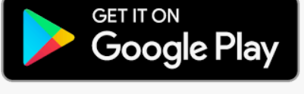
Google Play: your entertainment roadmap
A how-to guide demystifying the readable, playable, audible and productivity content in Android’s App Hub
Mike Yakavonis
February 2022

Slide 2
Tap your Avatar to review promotions, active subscriptions, and general settings
Back Next End

Slide 3
Search bar
If you know which content you’re looking for, type in the Search bar to retrieve it
Back Next End

Slide 4
Scroll among the categories to quickly find relevant content
Back Next End

Slide 5
Apps button
Tap here to view the most popular productivity options you can install

Slide 6
Offers button
Tap here to access promotional content tailored to your interests

